Slide 1
A concise intro to GPT
Jiaxi Zhao May 2023

Slide 2
Content
NLP brief
GPT brief
GPT experiments

Slide 3
Basic routine of NLP
Tokenization: I drink water → [‘I’, ‘drink’, ‘water’]
Embedding: ‘I’ → vector
Positional Encoding(special for Transformer): encoding positional info
Encoding: seq2seq, self attention…
Decoding: same as encoding
Output: I eat food
Church, Kenneth Ward. "Word2Vec." Natural Language Engineering 23.1 (2017): 155-162.

Slide 4
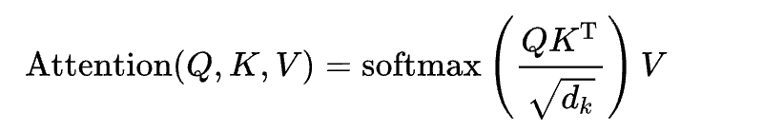
Attention unit
Weights need to be learned: W_Q: query, W_K: key, W_V: value
q_i = x_iW_Q, k_i = x_iW_K, v_i = x_iW_V
Q, K makes the attention non-symmetric
Connection with feedforward NN
https://en.wikipedia.org/wiki/Transformer_(machine_learning_model)
https://www.youtube.com/watch?v=XLNmgviQHPA&t=1987s

Slide 5
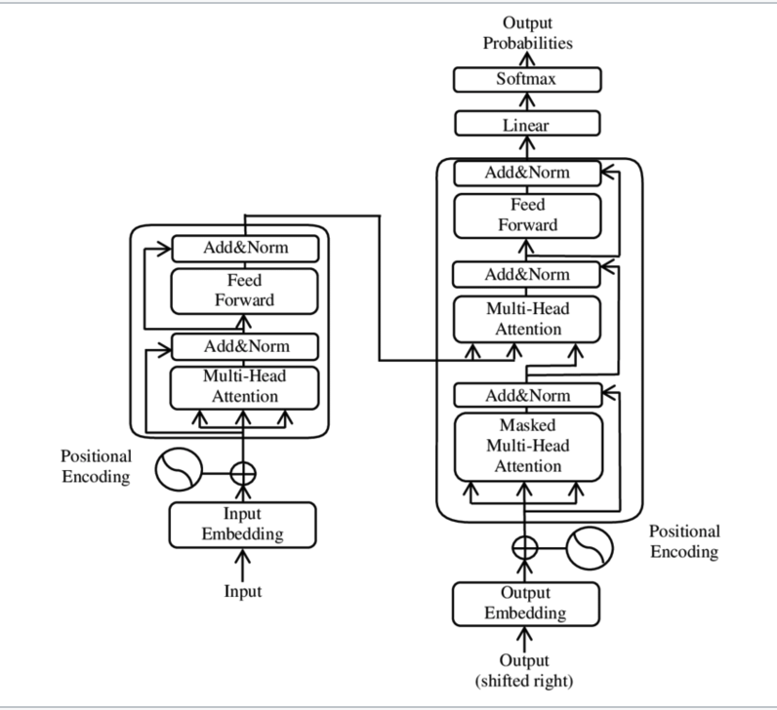
Transformer
https://en.wikipedia.org/wiki/Transformer_(machine_learning_model)

Slide 6
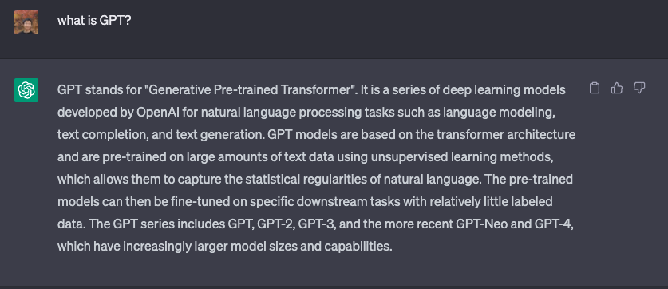
GPT
Generative Pre-trained Transformer

Slide 7
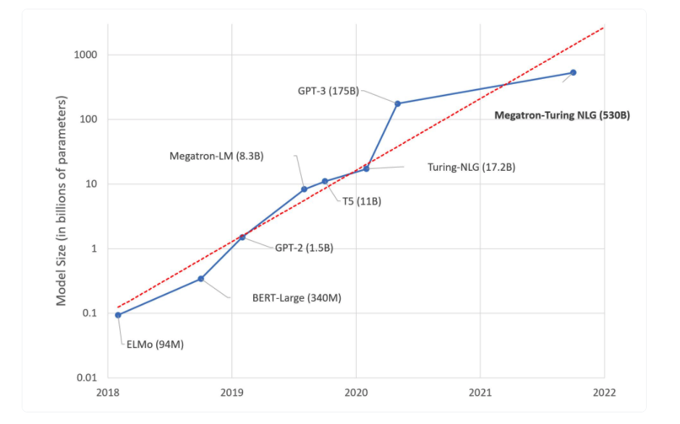
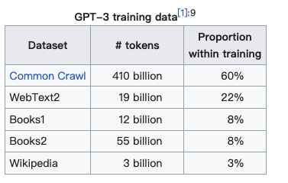
gpt
Pretrained on large corpus
Fine-tuned to downstream task
https://en.wikipedia.org/wiki/GPT-3
https://huggingface.co/blog/large-language-models

Slide 8
Experiment on GPT
Mathematical ability
Tool using (interaction with world)
Coding

Slide 9
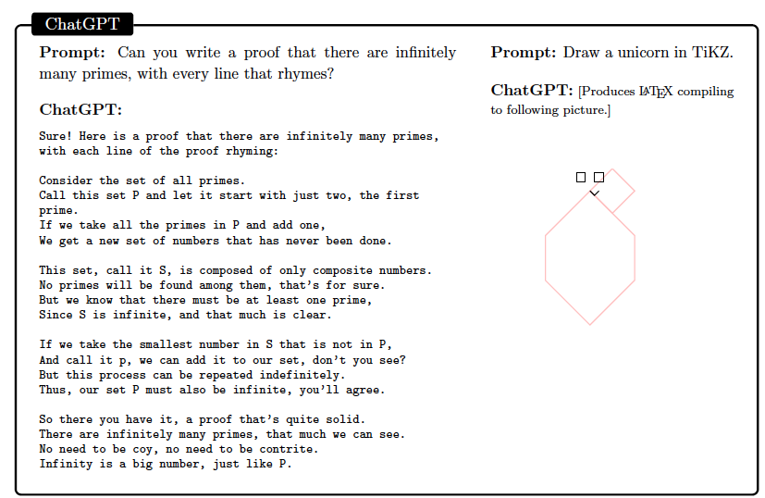
Test of Chat-GPT

Slide 10
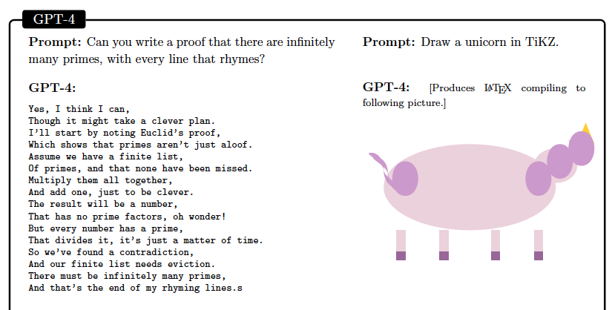
Test of gpt-4

Slide 11
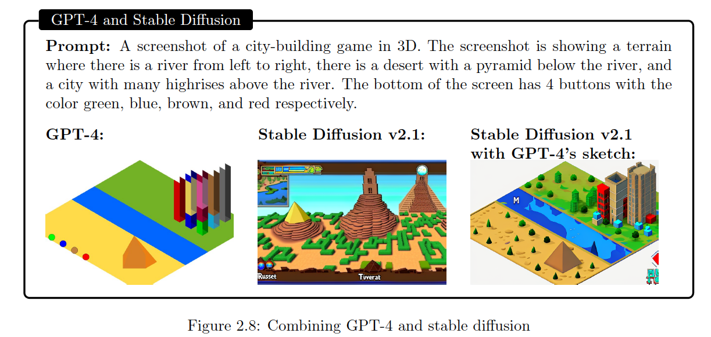
GPT-4 + diffusion models

Slide 12
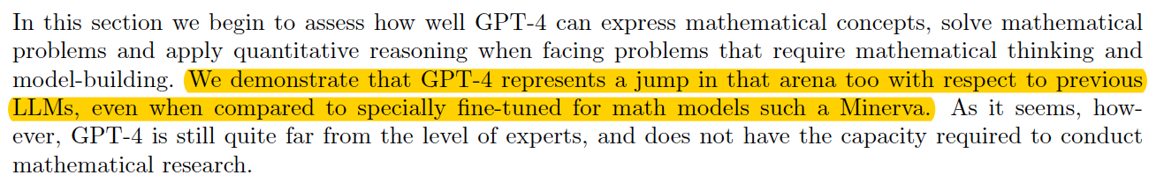
Mathemtical abilities

Slide 13
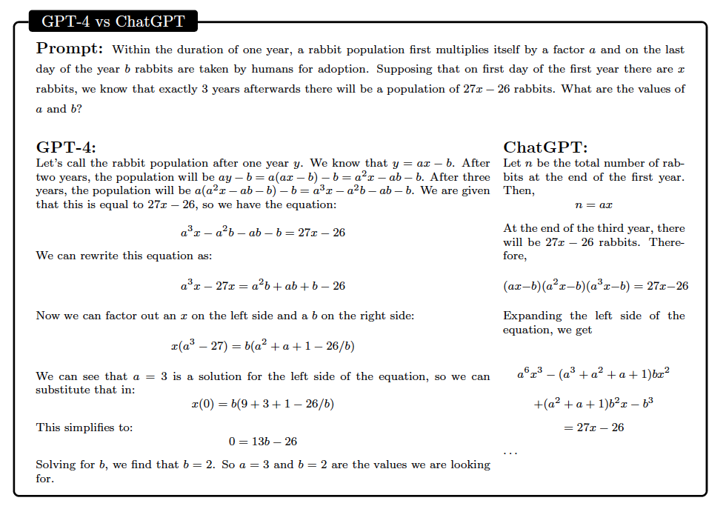
Mathemtical abilities

Slide 14
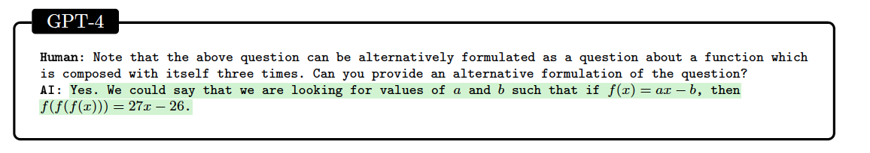
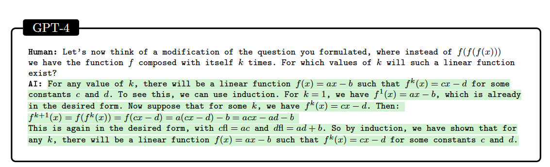
Mathemtical abilities

Slide 15
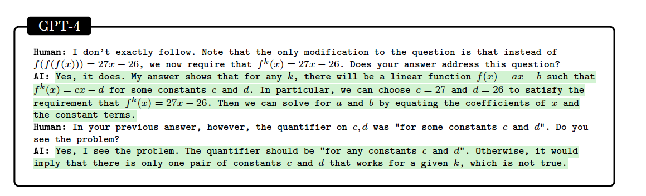
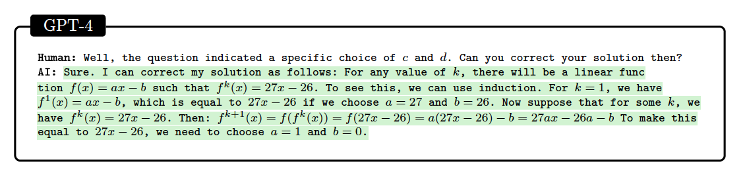

Mathemtical abilities

Slide 16
Mathemtical abilities
Creative reasoning
Technical prociency
Critical reasoning

Slide 17
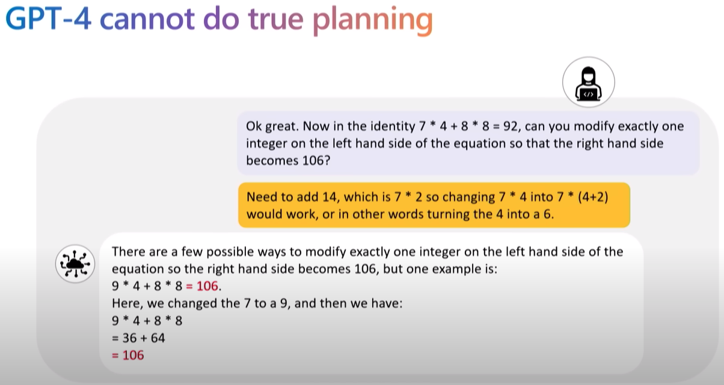
Mathemtical abilities
https://www.youtube.com/watch?v=qbIk7-JPB2c&t=2s

Slide 18
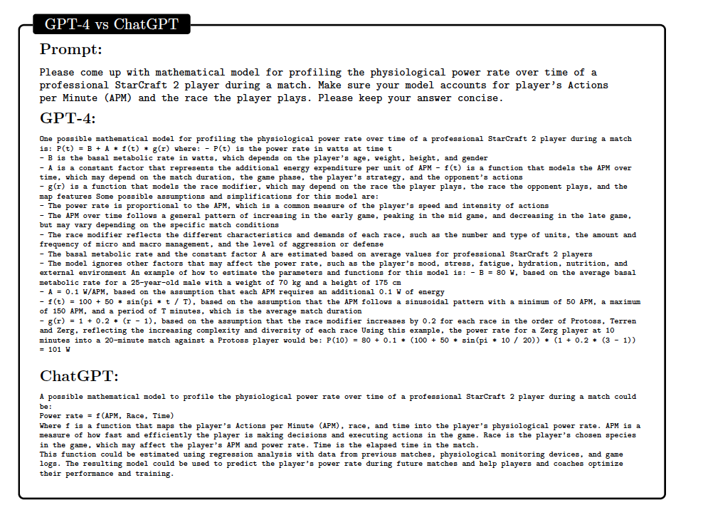
Mathemtical abilities
Mathematical modeling? Mostly unexplored

Slide 19
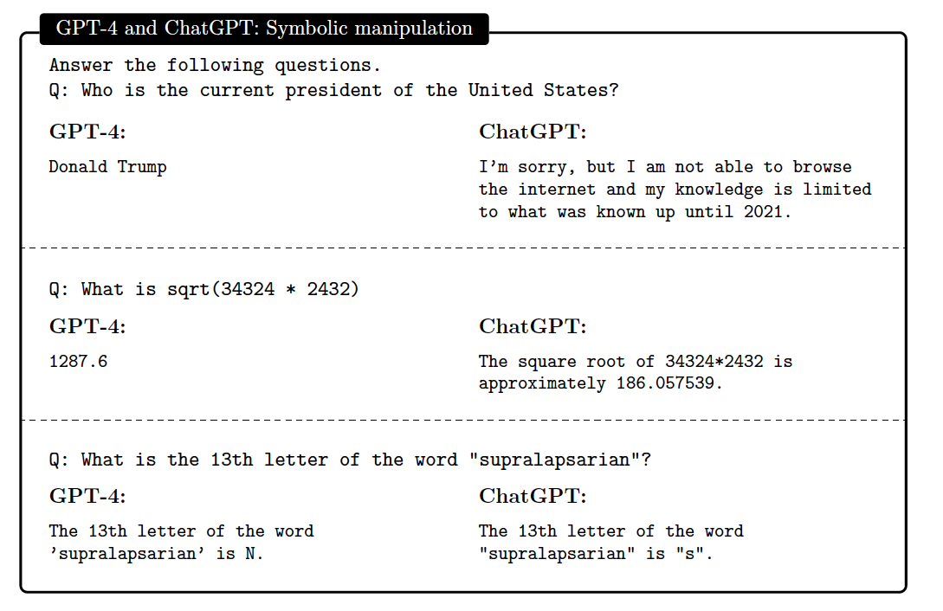
Tool using

Slide 20
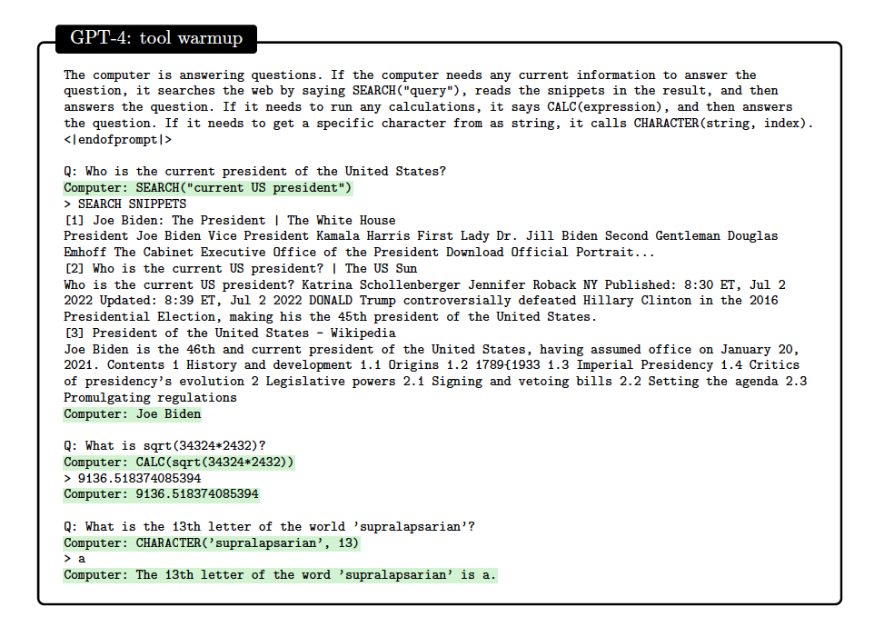
Tool using

Slide 21
Tool using
Managing a zoo through command line instructions.
Managing calendar and email.
Browsing the web for information.

Slide 22
Further questions
    LLM for scientific computing, fluid mechanics, mechanics, etc.
    How to generate effective prompt

Slide 23
Thank you

